Slide 1
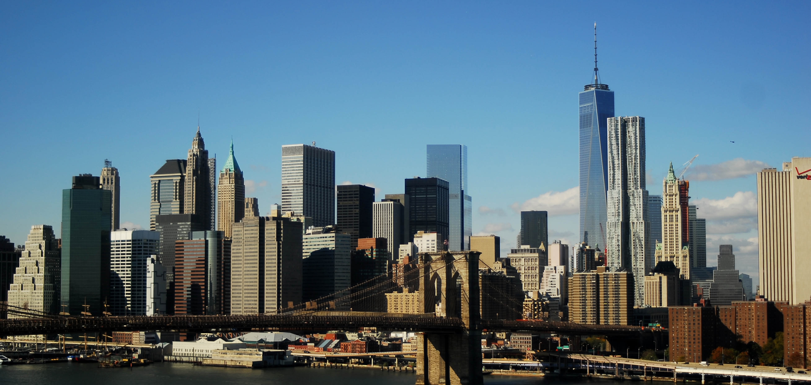
Image Generator: Skyline
APS 360 Project using GAN Network
Shuyang(Tom) Luo 1002926033
Yu(Russell) Wang 1003245990
Jiajie(Jeremy) Xu 1002937842

Slide 2
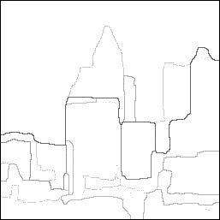
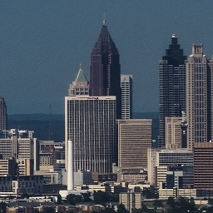
Goal
Motivation
Background generation in movie industry
Interesting project that nobody has worked on before

Slide 3
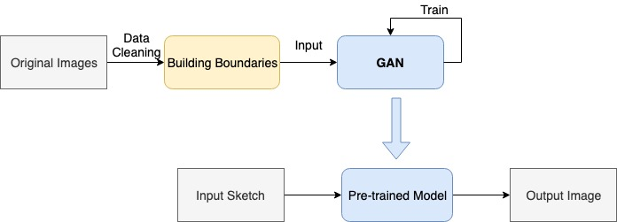
Overall Software Structure

Slide 4
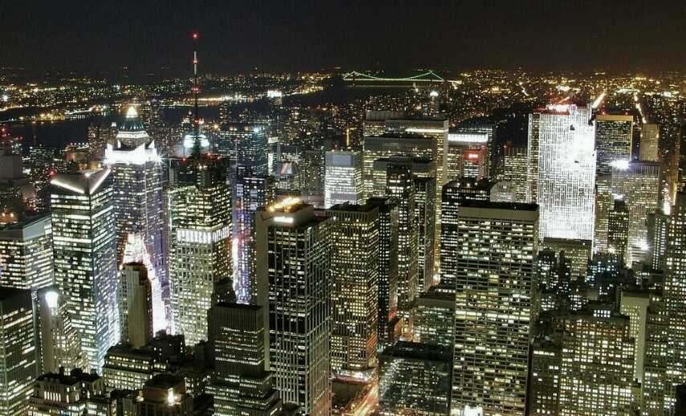
Data Collection
Lighting
Perspective
Unqualified Image

Slide 5
Data Cleaning
Data augmentation
Obtaining building boundaries
Notes:
Data collection: viewing angle, daylight condition, take out lakes or excessive sky

Slide 6
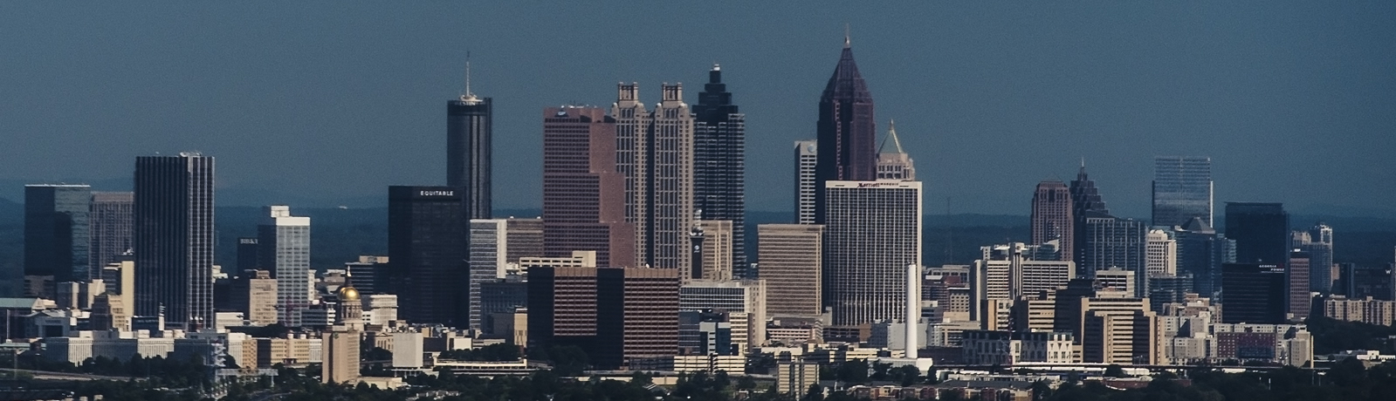
Data Cleaning
https://www2.eecs.berkeley.edu/Research/Projects/CS/vision/grouping/papers/amfm_pami2010.pdf
Notes:
Data collection: viewing angle, daylight condition, take out lakes or excessive sky

Slide 7
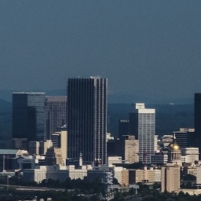
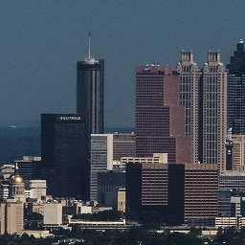
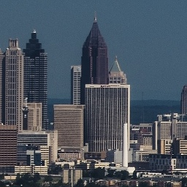
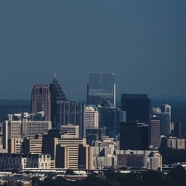
Data Cleaning
Crop
https://www2.eecs.berkeley.edu/Research/Projects/CS/vision/grouping/papers/amfm_pami2010.pdf

Slide 8
Data Cleaning
Crop
Resize
https://www2.eecs.berkeley.edu/Research/Projects/CS/vision/grouping/papers/amfm_pami2010.pdf

Slide 9
Data Cleaning
Crop
Resize
Flip
https://www2.eecs.berkeley.edu/Research/Projects/CS/vision/grouping/papers/amfm_pami2010.pdf

Slide 10
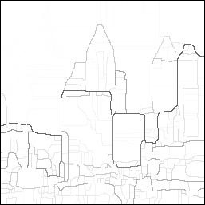
Data Cleaning
Crop
Resize
Flip
Apply Global Probability of Boundary (gPb)
https://www2.eecs.berkeley.edu/Research/Projects/CS/vision/grouping/papers/amfm_pami2010.pdf

Slide 11
Data Cleaning
Crop
Resize
Flip
Apply Global Probability of Boundary (gPb)
Denoise
https://www2.eecs.berkeley.edu/Research/Projects/CS/vision/grouping/papers/amfm_pami2010.pdf

Slide 12
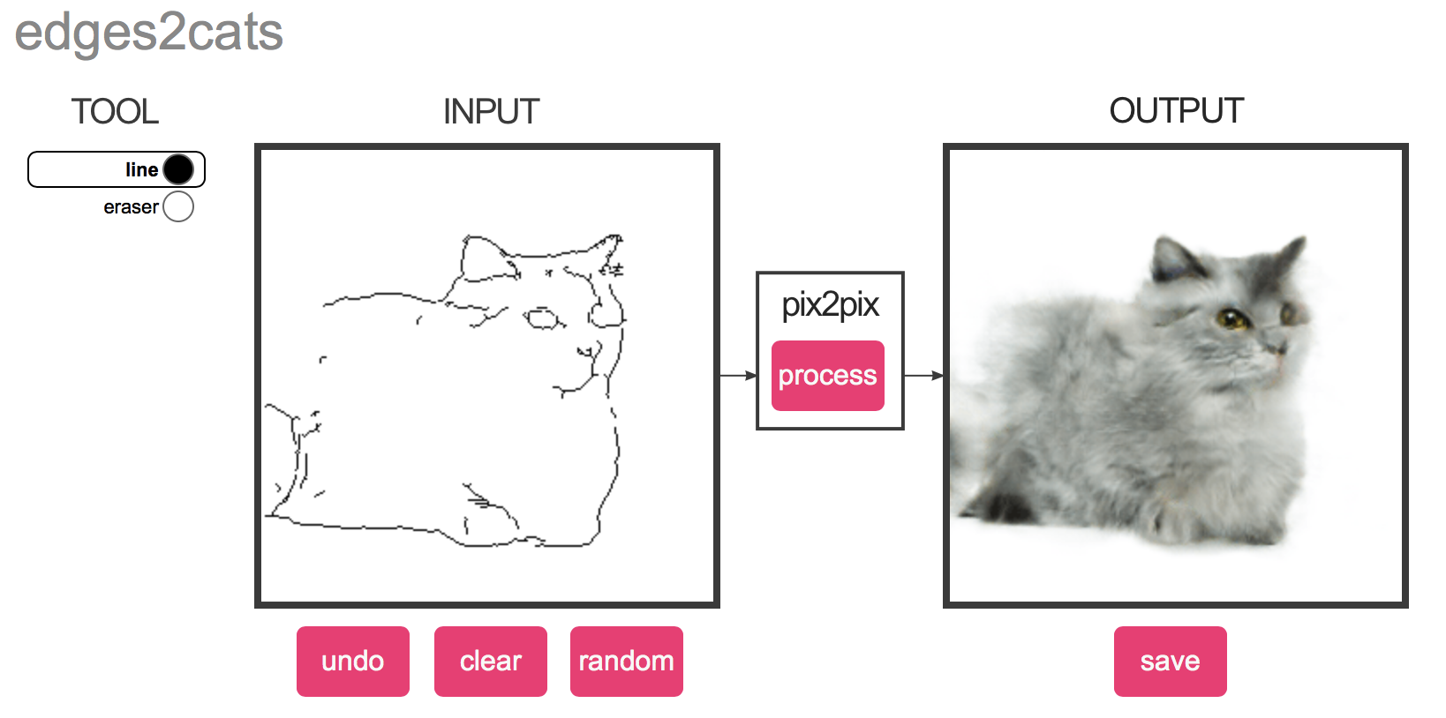
Machine Learning Model
Pix2Pix model
https://arxiv.org/pdf/1611.07004.pdf

Slide 13
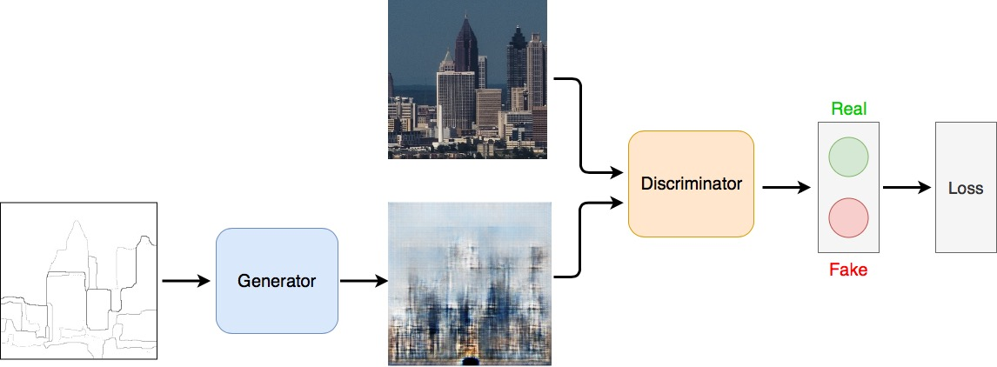
Machine Learning Model
Conditional GAN
Notes:
Instead of from noise, generator takes an input sketch (boundaries), so we can have some control

Slide 14
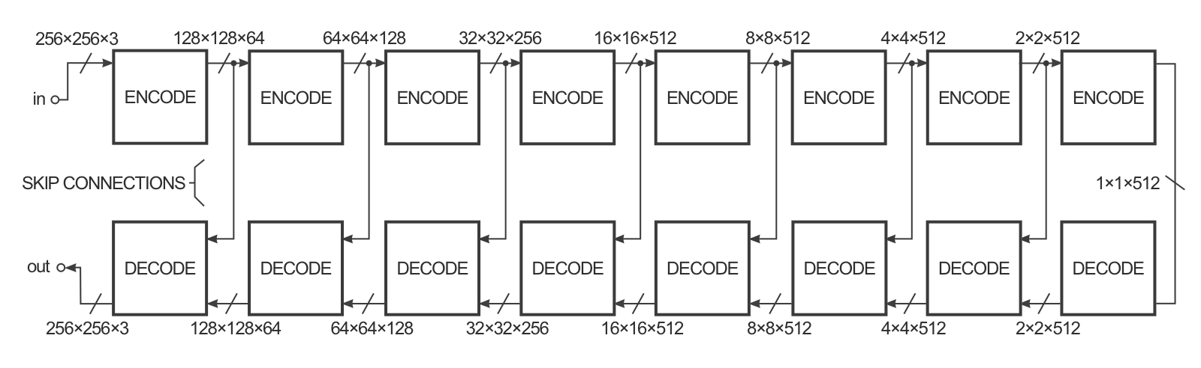
Generator
U-Net (Autoencoder + Skip Connection)
https://medium.com/@ManishChablani/cyclegans-and-pix2pix-5e6a5f0159c4
Notes:
Use skip connections that directly connect encoder layers to decoder layers
Information captured in encoder layers are fed into decoder layers

Slide 15
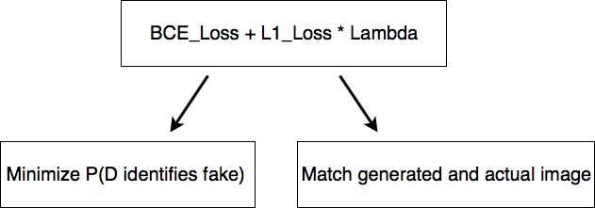
Generator Loss
Notes:
The loss for generator is also composed of two parts. First, generator is trying to minimize the probability that discriminator correctly identifies fake images. Also, since we have input boundaries, we want to match our input and output, so we added L1_Loss, which is the absolute value of input and output

Slide 16
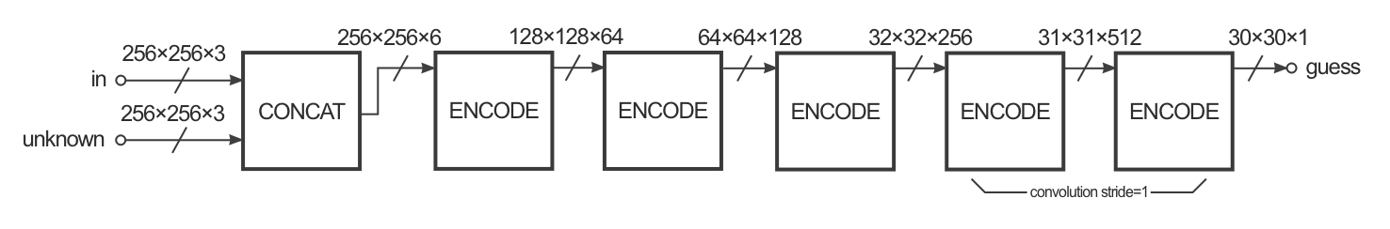
Discriminator
PatchGAN (70x70 patches)
Building Boundaries
Real or Fake
https://medium.com/@ManishChablani/cyclegans-and-pix2pix-5e6a5f0159c4
Notes:
PatchGAN: Regular GAN maps from a 256x256 image to a single scalar output, which signifies "real" or "fake".
However, PatchGAN maps the image to 70x70 overlapping patches. We run a regular discriminator over each patch, and averaged the results.

Slide 17
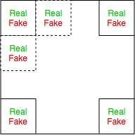

Discriminator
PatchGAN (70x70 patches)
70
1
1
70
Regular Discriminator
PatchGAN Discriminator
https://medium.com/@ManishChablani/cyclegans-and-pix2pix-5e6a5f0159c4

Slide 18
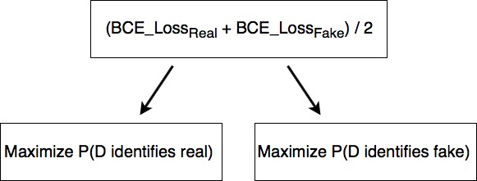
Discriminator Loss
Notes:
Same as what lecture talked about, the discriminator is trying to maximize the probability of identifying real and fakes images correctly. In our implementation, we are dividing the loss by 2 to slow down the training of discriminator with respect to the generator.

Slide 19
Optimizer and Hyperparameters
Adam Optimizer with Beta1 = 0.5, Beta2 = 0.999
Learning rate = 1e-4
Batch size = 64
Lambda = 1
Notes:
We chose to use Adam optimizer with beta1=0.5 and beta2 = 0.999, same as the pix2pix model. After some hyperparameter tuning, the final learning rate is 1e-4, batch size is 64 and Lambda =1

Slide 20
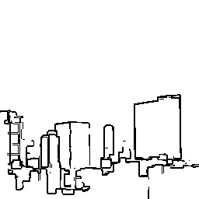
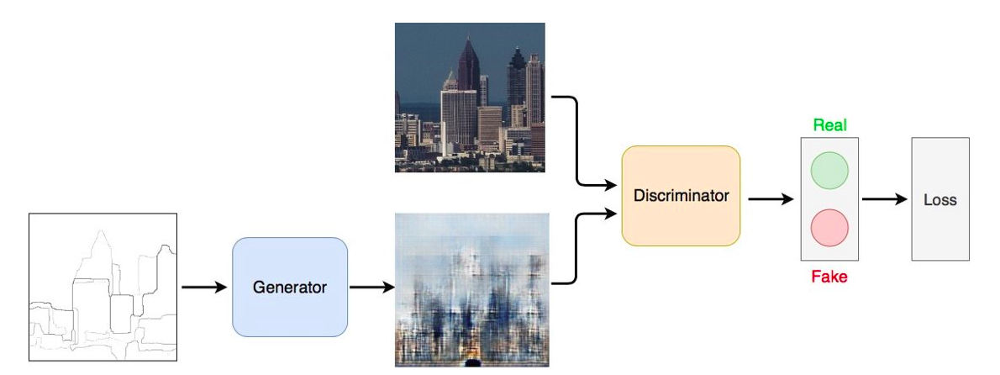
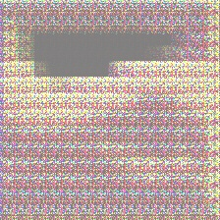
Training Result v1.0 “Mosaic”
OpenCV edge detection for input boundary
Autoencoder for generator
Binary classifier for discriminator
Binary Classifier
Autoencoder

Slide 21
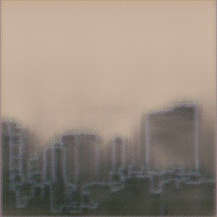

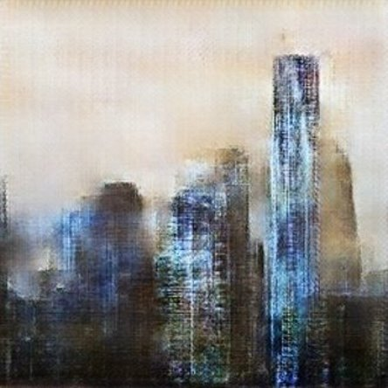
Training Result v2.0 “Canvas Spray”
Pix2Pix model
U-Net instead of autoencoder
PatchGAN as discriminator
Google cloud to train 200+ epochs
(Not from the same input)
PatchGAN
U-Net

Slide 22
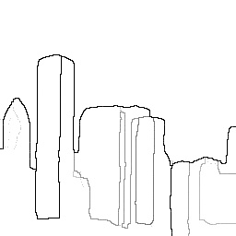
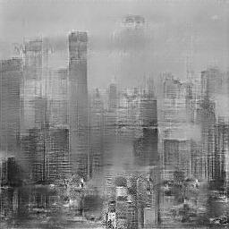
Training Result v3.0 “Foggy”
Change of input (gPb boundaries)
Dropout
Grayscale for simplicity
PatchGAN
GPb Boundary
U-Net
Dropout

Slide 23
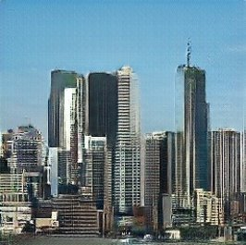
Training Result v4.0 “The City”
RGB image training
Different Lambda (generator L1Loss ratio) values
Hyper-parameters tuning
1000 epochs with early stopping
PatchGAN
gPb Boundary
U-Net
Dropout
Lambda

Slide 24
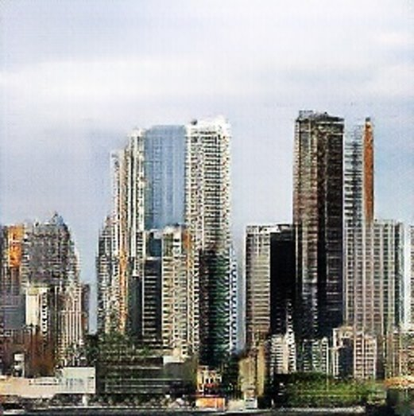
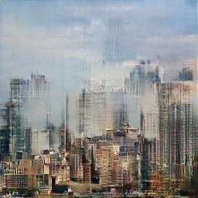
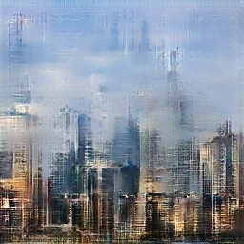
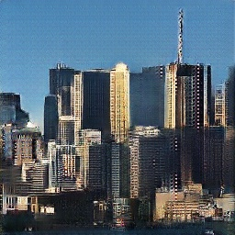
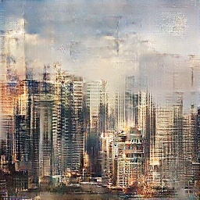
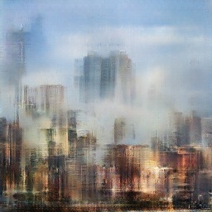
Different Lambda Values
λ = 1:
λ = 10:
λ = 100:

Slide 25
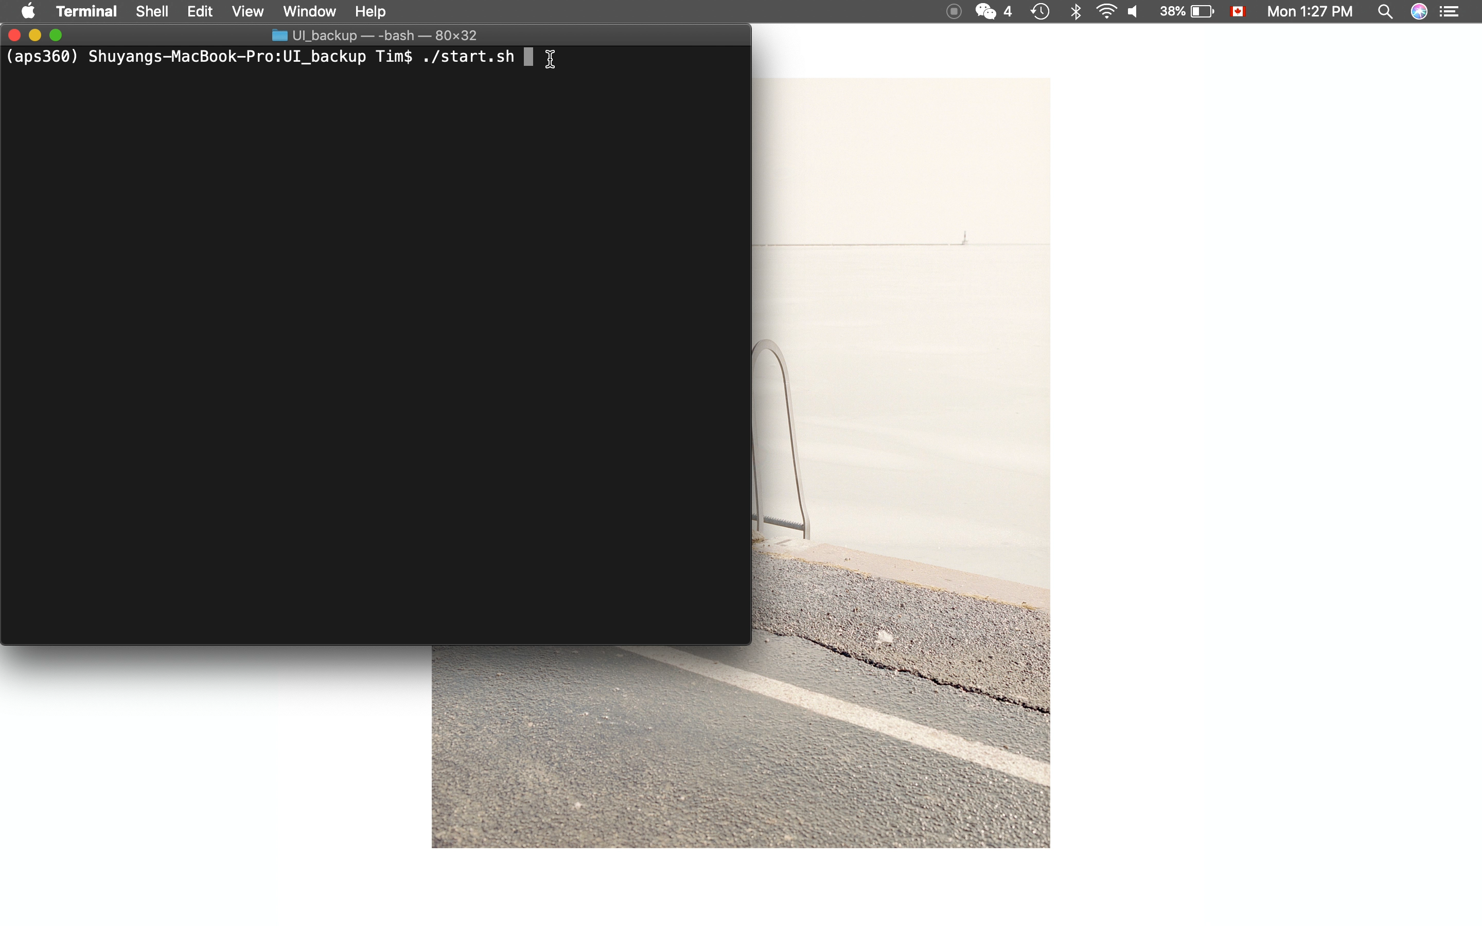

Slide 26
Key Learnings
Research
Planning
Computing Resource
Efficiency

Slide 27
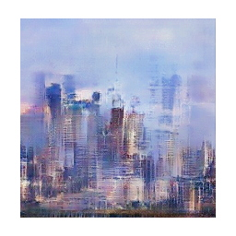

Thank you!
Our favorite image:
"Monet Impressionism" Skyline

